Slide 1
Week 4
Database schema

Slide 2

What is database schema?
In relational databases we need to organize the data
When data is organized we need a map or blueprint of it so we know how everything is put together
Schema can also be the rules or formulas for how the database is done
Schemas will create these rules to ensure data integrity is maintained

Slide 3
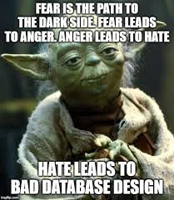
Why is this important?
Having a map or blueprint allows us to see at a glance the relationships of our database
Having rules for our database helps our data integrity, which is an important component to databases
Data is often "dirty" and that affects how it's used and the accuracy of results
A schema is also a good way to share this information in a concise way with others
A perfect database you can never share or have others use wouldn't be useful

Slide 4

What's included?
Database Schemas are likely to have
Tables with labeled fields
Primary key and foreign keys with relationships illustrated
Any rules or requirements for adding data
Notes on if particular data types are required
Schemas tend to include pictures and graphical representations to illustrate all of this

Slide 5
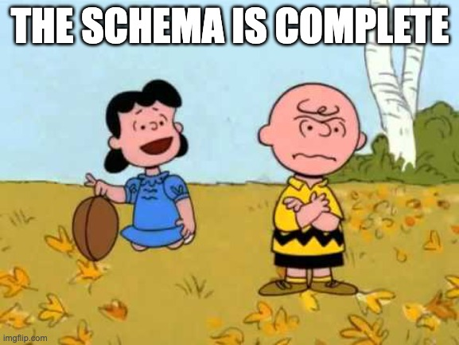
Advantages of having schema
Design Consistency, records of how the database was put together are useful for you and anyone that has to interact with it
Scalability – Well organized data and databases are easier to grow then if they were not well put together
Optimization – Knowing how the database is organized can help queries run faster
Maintenance– It's easier to fix and maintain a well-organized well documented database
Security – Having a plan of how you're storing and protecting your sensitive data means it's more likely to be followed by everyone

Slide 6
Types of schema
Physical schema
Explains how the data is stored on the actual storage
Usually will have the explanation including files and indices
Logical schema
Includes the relationships of the tables
The rules that the data has to follow are included here
Will include the ER modelling
View schema
How the end user will work with the database
To see this you don't need all the other information, so it might be easier for some people to follow

Slide 7
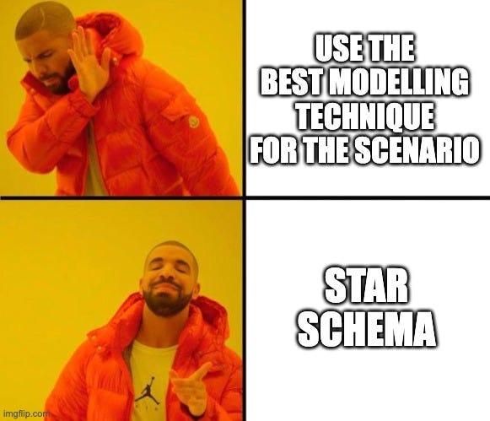
Schema Designs
There are a lot of potential design options for schema
They are chosen based on what makes the most sense for the data and application
Some examples of database schema design options
Flat Model
Hierarchical Model
Network Model
Relational Model
Star Schema
Snowflake Schema

Slide 8
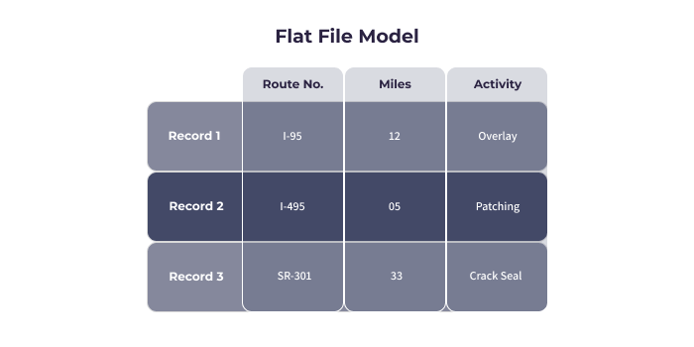
Example: Flat model schema
This is basically like a single table.
Very simple
Doesn't model all the data needs for more complex situations
Likely only useful if you could do a spreadsheet instead of a database
Might be used for a small company with only a few employees that need an employee database
https://www.integrate.io/blog/database-schema-examples/#two

Slide 9
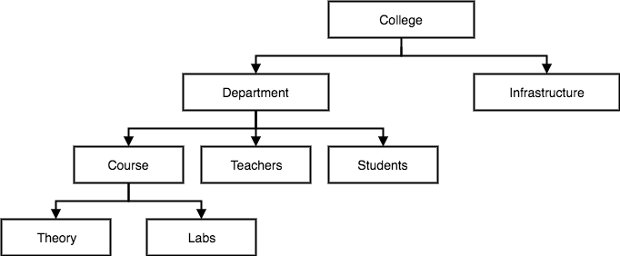
Example: Hierarchical model schema
Looks like a tree structure like you might see in programming data structures
Contains a root node where the information is starting from
Used for things like nested data because it's the parent/child model
An example use case for a school might be a database of employees and students
https://theintactone.com/2019/03/26/dbms-u1-topic-5-hierarchy-data-model-network-data-model/

Slide 10
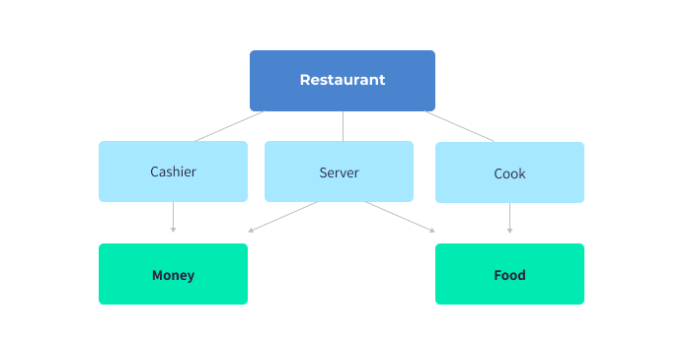
Example: Network model schema
Similar to the hierarchal schema
This allows many-to-many relationships to be illustrated, whereas networking only allows one-to-many
Network model schema means you can include workflows and paths to the data
Example use case might be a restaurant chain where you need to keep track of inventory and employees but you also want to model workflows for cash and food delivery
https://www.integrate.io/blog/database-schema-examples/#four

Slide 11
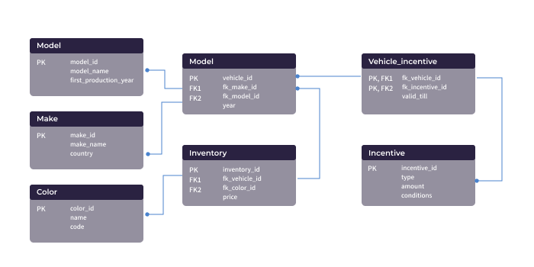
Example: Relational model schema
Mostly used in relational databases
Used to keep track of the table and relationships
Some say it's better for object-oriented design
Example use case in a school we have classes, faculty and students, departments and divisions, or other data that is related
https://www.integrate.io/blog/database-schema-examples/#five

Slide 12
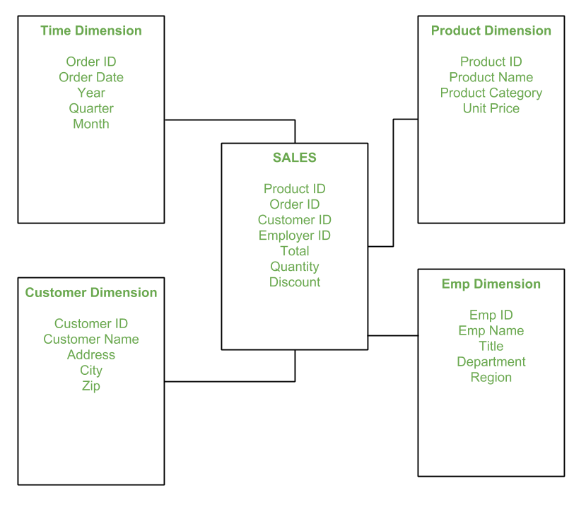
Example: Star model schema
Can be used for larger amounts of data
Used frequently for data marts and data warehouses
Has the general appearance of a star, where there is a central table called the fact table, and connected to that are the dimension tables that describe other important info
The relationships are described using foreign key relationships
https://www.geeksforgeeks.org/star-schema-in-data-warehouse-modeling/

Slide 13
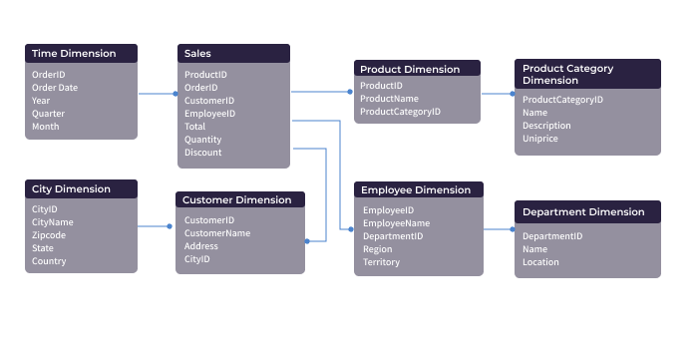
Example: Snowflake model Schema
Snowflake is an adaptation of the star schema
Like the star style, there is a central table that stores datapoints and references to dimensional tables
However it expands on star by allowing multiple dimensional tables to include even more information
Also commonly seen in data marts and data warehouses
Same example as star model, but used when more data is needed, such as breaking out a location table for customers, or departments for employees
https://www.integrate.io/blog/database-schema-examples/#seven

Slide 14

Schema

